Slide 1
PROJECT RAPTORS REBOUND
DAT 205 Capstone Interim Progress
Group 1 - Bhavika Patil, Cindy Guo, Dennis Hung
Notes:
Good evening Everyone,
Today, we Group 1; Myself – Bhavika, Cindy and Dennis are going to present the progress we have made on our Project RAPTORS REBOUND
[NEXT SLIDE]

Slide 2
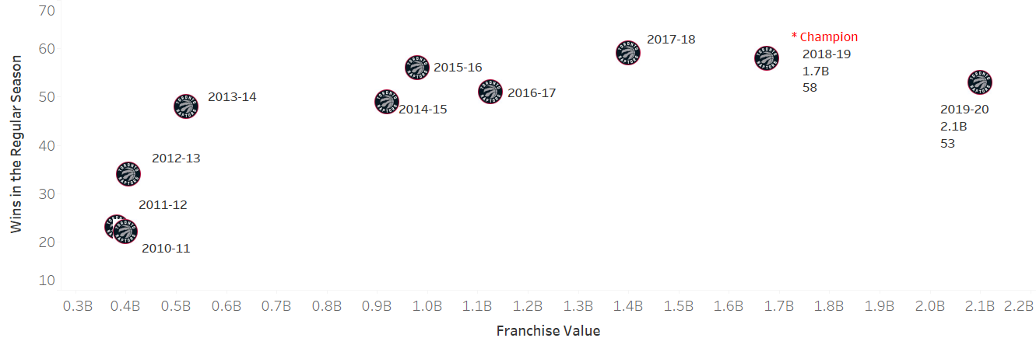
The Client
The Toronto Raptors are an NBA championship team with a USD2.1 billion market capitalization in 2020.
The team’s General Manager (GM) and owners are seeking recommendations on improving the team’s chances at another championship run while preserving the team’s long-term future.
Notes:
The Client
[NEXT 01 – Graph]
Pause for effect
[NEXT 02 – Raptors]
Our client is Toronto Raptors, Currently the only Canadian NBA franchise.
In 2020, The Toronto Raptors’ valuation was estimated to be 2.1 billion USD. The raptors won their first NBA Championship in 2019. However, the team’s performance has been in decline since then. This chart shows the wins for each year for Toronto raptors.
[NEXT 03 – GM]
The team’s General Manager is seeking recommendations on improving the team’s chances at another championship run while preserving the team’s long-term future. The suggestions will be in the form of improvements to the player roster. The stakeholders intend to either maintain or improve on the number of wins during the regular season and more importantly during the playoffs while retaining the public interest in the team.
[NEXT SLIDE]

Slide 3
Objectives
The primary objective of this analysis is to determine which features are important to the Toronto Raptors team to produce more wins in the regular season and the playoffs.
The secondary objective is to review team players’ performance-to-cost effectiveness.
Focus on the historical player data from 2005 to 2020 as this closely represent the players of the current era.
Notes:
To attain the requirements outlined by the management, we are looking at two objectives
[NEXT 01 – Primary Objective]
The primary objective of this analysis is to determine which features are important to the team to produce more wins in the regular season and the playoffs.
[NEXT 02 - Secondary Objective]
The secondary objective is to review team players’ performance-to-cost effectiveness.
[NEXT 03 – Data scope]
The scope of this analysis will be to focus on the historical player data from 2005 to 2020 as this closely represents the players of the current era. The performance baseline of the team and players will be established using the data for The Toronto Raptors 2019-2020 season. These statistics will be used to indicate performance features for the team and the individual players.
[NEXT SLIDE]

Slide 4
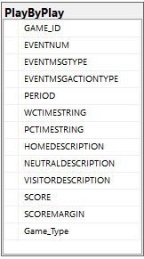
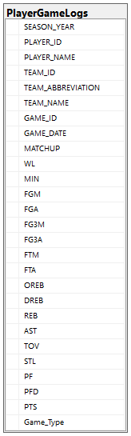
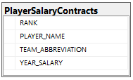
Data
Open access API (nba_api)
PlayerGameLogs
Total 465065 records, 36 features
PlayByPlay
Total ~10M records, 13 features
NBA Player Salaries
ESPN for the historical data
Hoopshype for future data
489 records
Notes:
The data collection for this analysis was a cumbersome process. We have used multiple sources to gather the data.
[NEXT 01 – API]
nba_api is an open access API client library for Python requesting the data via webservices through stats.nba.com.
[NEXT 02 – Player Game Logs endpoint]
Playergamelogs endpoint fetches player statistics for each game.
There are more than 22000 games in this dataset consisting of more than 450k rows. We are using and 36 features
We are only showing a few features here, this dataset acts as the main datasource for the analysis.
[NEXT 03 – Play by Play endpoint]
PlayByPlay gets all activities for a game, we fetched stats for all games of the first dataset. This took some time since it’s a lot of API requests with some wait in-between.
This dataset can reference the main table by GAME_ID.
[NEXT 04 – Player salaries]
NBA webservice does not provide the salary data. We ended up using additional means of data collection.
Historical salary data was drawn from ESPN website and the future salary data from HoopsHype website. These were obtained using web scraping in python using web scraping library. These contain data for current 489 NBA players
We can relate this table to the Playergamelogs using the Player name and the Team Abbreviation.
[Just pause for a couple of seconds]
To easily explain the schema, we created this database diagram using SQL and visio. Since this is not a normalized database; which would be very expensive for this analysis, the primary and foreign keys are not enforced by a constraint.
[Next speaker handoff statement]
Now I shall hand off to Dennis
[NEXT SLIDE]

Slide 5
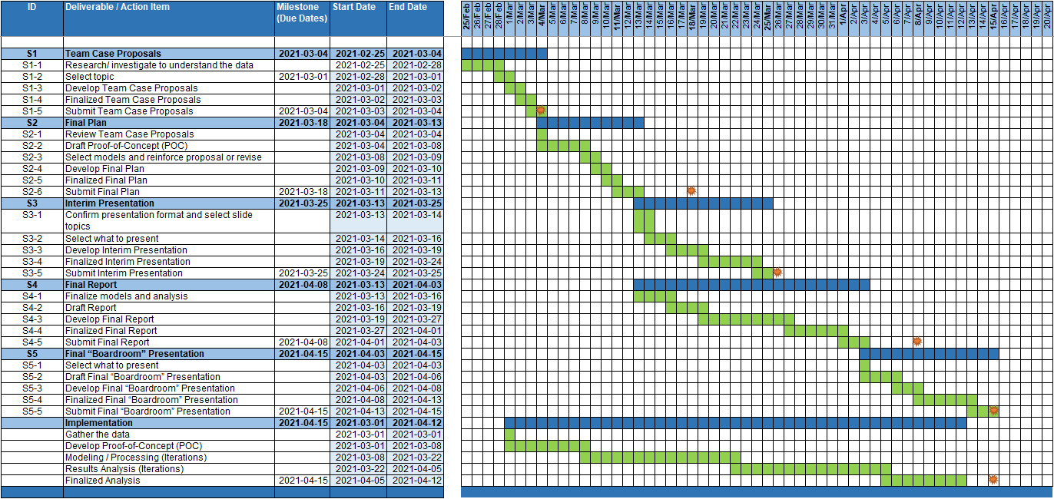
Project Planning
Notes:
[Dennis to take over,]
Thank you Bhavika. I will continue on to the next part of Project Planning.
[NEXT 01 – Project plan]
We created a project plan based on the deliverables requested of us and delivery dates. In this situation our project is allocated into 5 phases
[NEXT 02 – Project plan]
Proposal, Final Plan, Interim Presentation, Final Report and Final Presentation
[NEXT 03 – milestone]
with a milestone date to show the completion of a deliverable. We would work backwards from these milestone dates to determine the minimum duration of each phase.
[NEXT 04 – Final date] Fix
Completion of the final report is targeted for Apr 8th along with a final presentation on Apr 15th summarizing the results outlined in the final report.
[NEXT 05 – Implementation]
The last unlabeled grouping was to track our overall development schedule relative to the our primary deliverables.
[NEXT SLIDE]

Slide 6
Project Team
Team Roles
Project Manager
Data Scientist
Programming Architect
Team communications
Schedule meetings (3+ times per week)
MS Teams, WhatsApp, email
Git and Google Drive
Notes:
[NEXT 01 – Team]
Our team was a very loose form of Scrum Agile. Everyone had input in each part. If we need to designate roles we defined it as
[NEXT 02, 03, 04 – Roles]
Project Manager where I (Dennis) handled scheduling and administrative duties
Data Scientist where Cindy’s role to help understand the data and some initial trends in the data.
Programming Architect where Bhavika’s role taking care of our business unit’s division of coders (everyone in the group)
[NEXT 05 – Communications]
We had multiple methods to facilitate team communications
[NEXT 06 – Meetings]
We had scheduled meetings 3 times per week to align on
what each of us had done
what we will do next
discuss challenges, next steps, and shared knowledge
[NEXT 07 – Meetings]
Various methods (MS Teams, WhatsApp, Email) to contact each other for redundancy as technology can fail
[NEXT 08 – Repositories]
Use repositories such as Git and Google Drive to maintain our documentation and code
This agreed upon structure helped facilitate our team relationships to work effectively and especially share knowledge. Only 1 of the 3 members had specific understanding of the dataset subject which was passed along to the group as we all became more familiar with the data. We created documents (reference, meeting minutes) to retain useful information, techniques, and ideas for future reference. All of this was stored on Google Drive before going with Git as the main repository for this project.
[Next speak handoff statement]
Now I shall hand off to Cindy
[NEXT SLIDE]

Slide 7
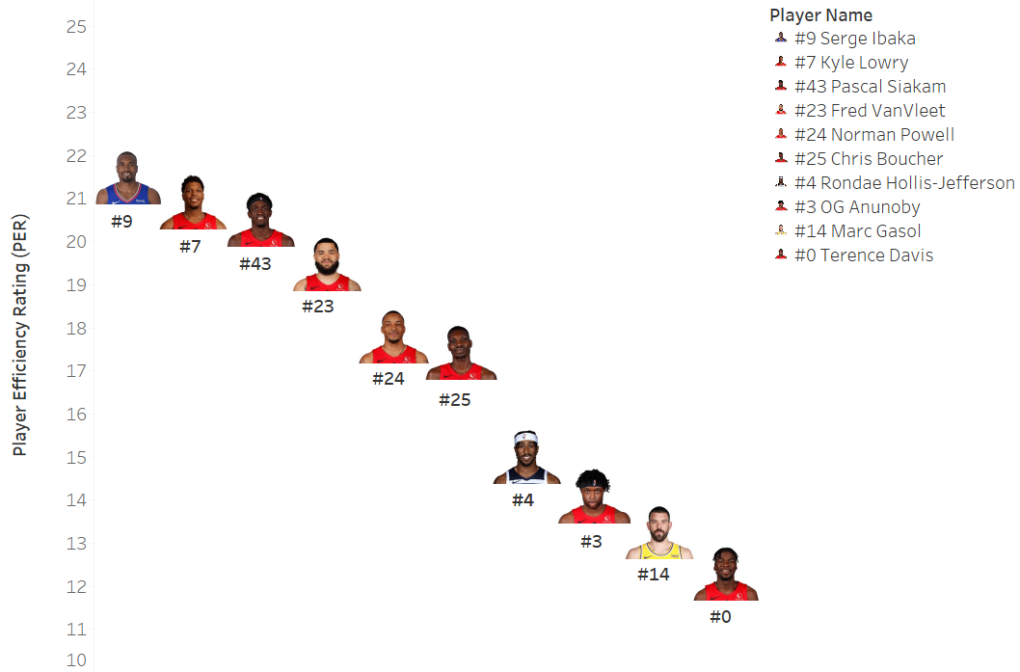
Initial Analysis
Top 10 Toronto Raptors Player Efficiency Rating (PER) for Season Year 2019-20
PER=[ FGM x 85.910 + Steals x 53.897+ 3PTM x 51.757 + FTM x 46.845 + Blocks x 39.190 + Offensive_Reb x 39.190 + Assists x 34.677
+ Defensive_Reb x 14.707 - Foul x 17.174 - FT_Miss x 20.091 - FG_Miss x 39.190- TO x 53.897 ] x (1 / Minutes)
Notes:
[Cindy to take over]
Thank you, Dennis. I will continue on to the next part of Initial Analysis.
Our initial analysis is focused on the Toronto Raptors since the Team’s performance will be the baseline for our analysis. This data consists of 15K records for this team alone.
[NEXT 01 – The slide is to show the topic for our study]
First, we determine the most efficient players for Toronto Raptors in the season 2019-20. The Player Efficiency Rating (PER) is introduced in our analysis.
PER is John Hollinger's all-in-one basketball rating, which attempts to boil down all of a player's contributions into one number. The formula is listed as below.
[NEXT 02 – The slide is to show the formula]
PER takes into account accomplishments, such as field goals, free throws, 3-pointers, assists, rebounds, blocks and steals, and negative results, such as missed shots, turnovers and personal fouls. The formula adds positive stats and subtracts negative ones through a statistical point value system. The rating for each player is then adjusted to a per-minute basis.
There are other PER formulas as well which may be different from the one we use.
[NEXT 03 – Player Performance Graph]
This graph shows the top 10 Player Efficiency Rating for Toronto Raptors in the Season 2019-20. The horizontal axis is the player names. The vertical axis is the PER number for each player. The analysis includes both Regular and Playoffs.
[NEXT 04 – Jersey]
The Jersey number is highlighted for each player under the photo.
[NEXT 05 – Serge]
From the PER calculation, Serge ranked No.1 in the season 2019-20 with a value of 21.50.
[NEXT SLIDE]

Slide 8
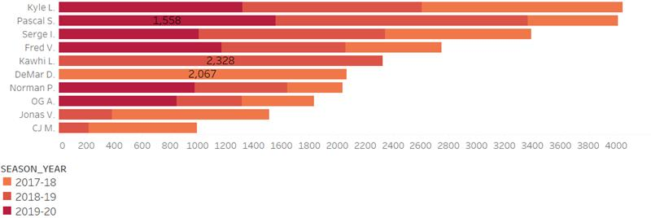
Initial Analysis
Top 10 Toronto Raptors Players by Points for the Seasons 2017-2020
Notes:
[NEXT 01 – Top 10 Toronto Raptors Players by points for the past 3 Seasons]
Let’s talk about who scored the most points in the last 3 seasons.
[NEXT 02 – Graph]
In this graph, it shows the top 10 players and their points. The horizontal axis is the total points scored in the last 3 seasons. The vertical axis is the player names.
We only study the players who scored at least 100 points in both Regular and Playoffs. The different color on the stack bar is for the different seasons. The darker indicates the recent season vs light color old seasons. Some players may have contracts with Raptors for only one season, we will see only one color on the stack bar.
[NEXT 03 – DeMar]
In 2017-18 season, DeMar was No. 1 with 2067 points.
[NEXT 04 – Kawhi]
In 2018-19 season, Kawhi had the highest score with 2328 points.
[NEXT 05 – Pascal]
In 2019-20 season, Pascal Ranked No. 1 with 1558 points.
[NEXT 06 – Kyle]
In all 3 seasons, Kyle scored the highest points and followed by Pascal.
[Next speaker handoff statement]
Now I shall hand off back to Dennis
[NEXT SLIDE]

Slide 9
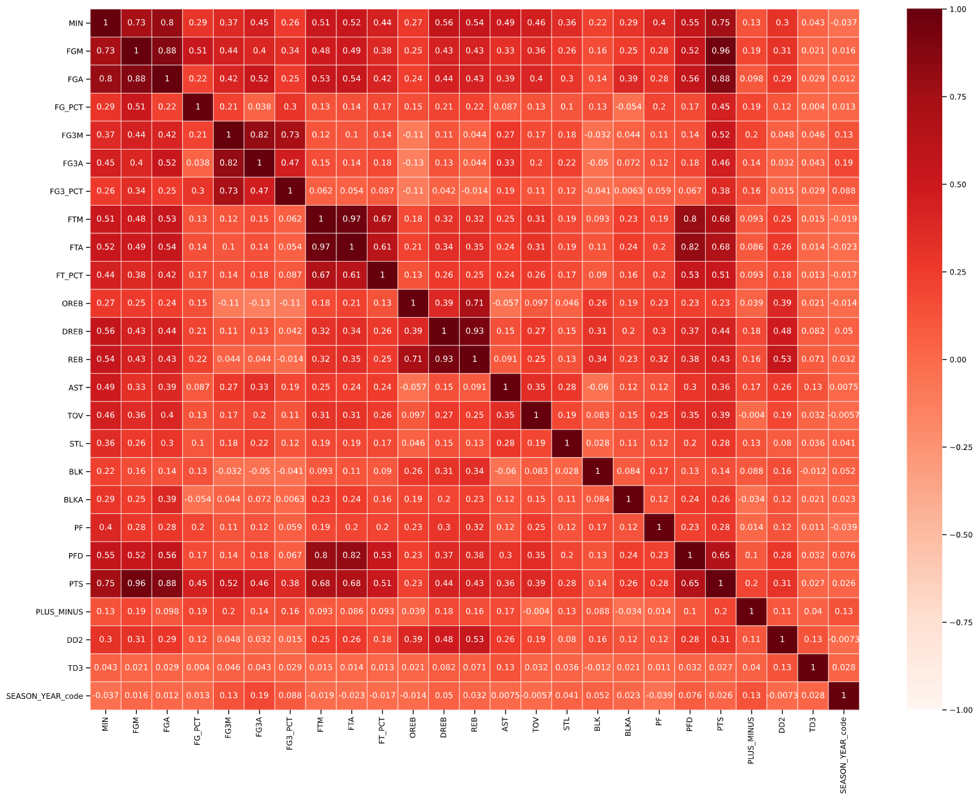
Preliminary Results – Correlation Matrix
Notes:
[Dennis to take over,]
I will continue on to the next part of showing you our Preliminary Results. Note these results are before any tuning is applied.
[NEXT 01 – Correlation matrix]
Of the original features
Another 8 more numerical/categorical features were drop as theses were providing redundant player or game specific information
unwanted_numerical_Features = ['PLAYER_ID', 'TEAM_ID']
unwanted_categorical_Features = ['PLAYER_NAME', 'TEAM_ABBREVIATION', 'TEAM_NAME', 'GAME_ID', 'GAME_DATE', 'MATCHUP’]
Thus reduced our overall dataset to 26 features for the preliminary analysis which includes our target feature (WL for WinLoss)
We created a correlation matrix between features. Here we line up our 25 features on the X and Y axis to determine how closely related each of these features are to each other. A dark red or 1 value represents a direct correlation and a light red or white is 0 for little or no relation.
​
[NEXT 02 – heat map focus]
Highlighted boxes indicate high correlation between some features (It is greater than 0.8 ). We were able to dropped 6 more features to reduce this feature redundancy: unwanted_list_02 = ['PTS', 'FGA', 'FG3M', 'FTM', 'PFD', 'REB’]
[NEXT SLIDE]

Slide 10
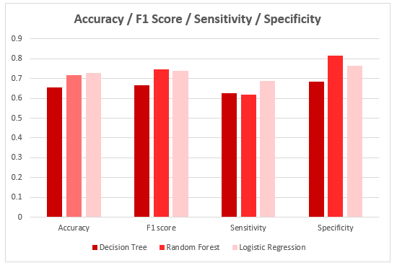
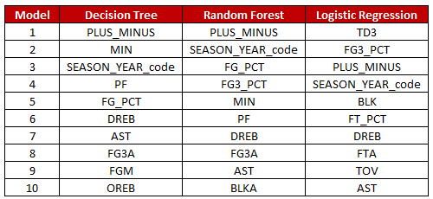
Preliminary Results
Feature Importance
Notes:
For our analysis we compared the performance of these 3 models (Decision Tree, Random Forest, Logistic Regression) to 4 metrics:
[NEXT 01 - show graph]
Accuracy – How well the model make True predictions
F1-Score - How well the model make Negative predictions
Sensitivity - The test of confirming True Positives.
Specificity – The test of confirming True Negatives
When comparing the 3 different models, it was a coin toss between Random Forest and Logistic Regression . The metrics of each model were quite similar for
[NEXT 02 – Focus on accuracy and F1 scores]
Accuracy (71.9% vs 72.8%) and F1 scores (74.7% vs 74.1%). The separate was much more noticeable for
[NEXT 03 – Focus on other 2 ]
Sensitivity (61.9% vs 69%) and Specificity (81.7% vs 76.6%).
[NEXT 04 – Feature Importance]
We had each model determine feature importance. For comparison purposes, we simply took the top 10 features as determined by each model. Focusing on our favoured models (center and right) each model have 3 features in common in the top 5 (PLUS_MINUS, SEASON_YEAR_code, FG3_PCT). The features (PLUS_MINUS, FG3_PCT) easier to assess (you score more you win games ) but we will need to better understand if SEASON_YEAR_code is an acceptable feature to keep.
[NEXT SLIDE]

Slide 11
Preliminary Recommendations
01
Game outcomes are more likely determined if the Toronto Raptors shoot well from 3 point range
02
Game outcomes are more likely determined if the Toronto Raptors shoot well from 3 point range
Notes:
If we were to go with Logistic Regression, our preliminary results initially point to the Toronto Raptors being able determine a game’s outcome if their perimeter players shoot efficiently from the 3 point range and if at least one of their
[NEXT 0x – key statement for animation]
[Speaker’s talking points on the current slide item]
[NEXT SLIDE]

Slide 12

THANK YOU
Notes:
This concludes our interim progress presentation.
Are there any questions?
Are there any ideas or suggestions?

Slide 13
Preliminary Results
Data cleansing
Transformation
Enhancing
Encoding
Reducing
Correlation matrix
Notes:
[Dennis to take over,]
I will continue on to the next part of showing you our Preliminary Results. Note these results are before any tuning is applied.
[NEXT 01 – Data cleaning]
From an initial analysis of the data we found 740 Preseason records with null values. Given this was Pre Season data for a redundant feature (player name) we opted to drop this data group from the analysis.
[NEXT 02 – Transformation]
Next, we looked transforming the data by Enhancing, Encoding, and Reducing
[NEXT 03 – Transformation details]
We enhanced the data (adding in features such as Game_Type to separate data by 3 groups Pre season, Regular Season, and Playoffs)
Categorical features were encoded to use numerical values by mapping or Label Encoding (ie SEASON_YEAR)
To reduce dataset further we drop visibly irrelevant features
As Bhavika mentioned earlier there were 30 features that were initially dropped as these were only rankings used for fantasy drafting (aka sport betting)
Another 8 more numerical/categorical features were drop as theses were providing redundant player or game specific information
unwanted_numerical_Features = ['PLAYER_ID', 'TEAM_ID']
unwanted_categorical_Features = ['PLAYER_NAME', 'TEAM_ABBREVIATION', 'TEAM_NAME', 'GAME_ID', 'GAME_DATE', 'MATCHUP’]
This reduced our overall dataset to 26 features for the preliminary analysis which includes our target feature (WL for WinLoss)
[NEXT 04 – Correlation matrix]
Next, we further wanted to see the correlation between features. Here we line up our 25 features on the XY axis to determine how closely related each of these features are to each other. A dark red or 1 value represents a direct correlation and a light red or white is 0 for little or no relation.
​
[NEXT 04 – heat map focus]
Highlighted boxes indicate high correlation between some features (It is greater than 0.8 ). We were able to dropped 6 more features to reduce this feature redundancy: unwanted_list_02 = ['PTS', 'FGA', 'FG3M', 'FTM', 'PFD', 'REB’]
[NEXT SLIDE]

Slide 14
[Template - Insert Title]
Notes:
[name to take over,]
Thank you, [Insert name]. Hello all, this is [Insert name]. I will continue to talk about [Insert next subject].
Thank you [Insert name]. I will continue on to the next part of [Insert next subject].
[NEXT 0x – key statement for animation]
[Speaker’s talking points on the current slide item]
[Next speak handoff statement]
Now I shall hand off to [Insert name]
[NEXT SLIDE]

Slide 15
Assumptions
01
Toronto Raptors only Play for NBA
02
The stats of games before 2005 are irreverent for current performers
Notes:
[NEXT 0x – key statement for animation]
[Speaker’s talking points on the current slide item]
[NEXT SLIDE]

